Slide 1

EYE SPY
Team Members
Anusha Verma - Problem
Alexander Moore - Solution
Sai Krishna Korukoppula – Available competition in market
Farzad Ahmed Shaik – Business scaling

Slide 2
PROBLEM
Going out and concerned if your house is safe or not or someone may break in.
Setting up new smart devices is very complex and costly.
Most of the smart devices save data on cloud and charge a high monthly subscription to store data on cloud.
If a person has already invested in a security system bringing a whole new system will add up to new charges and the money invested in earlier system will be wasted.

Slide 3
EYE SPY
Target Market
B2C
Any house owner/renter concerned about security for the place they are living in.
B2B
Any Seller who sells security cameras can collaborate with us
Value Preposition
Convenient
Affordable
Effortless

Slide 4
SOLUTION
Using deep learning AI facial recognition to detect unauthorized individuals on camera.
OpenCV
Our product is software - only
Requiring security cameras to already be installed
Saves on additional cost and setup
Live video feed rids the necessity of cloud storage
Distributed computing system results in increased performance
Each computer in a cluster can handle different tasks simultaneously
Notes:
OpenCV is a facial recognition library that is used to find faces within an image.

Slide 5
CONCEPTUALIZATION & JUSTIFICATION
The concept for this product came as a result of brainstorming ideas
Pathways to the nearest hospitals for COVID-19 patients.
Facial recognition to detect who is wearing masks and who is not.
Facial recognition to alert homeowners of unauthorized individuals.
Although our product does not fit within the scope of COVID-19, it does fit within the scope of Internet of Things
Sensors/Cameras
Connectivity
Data Processing
User Interface

Slide 6
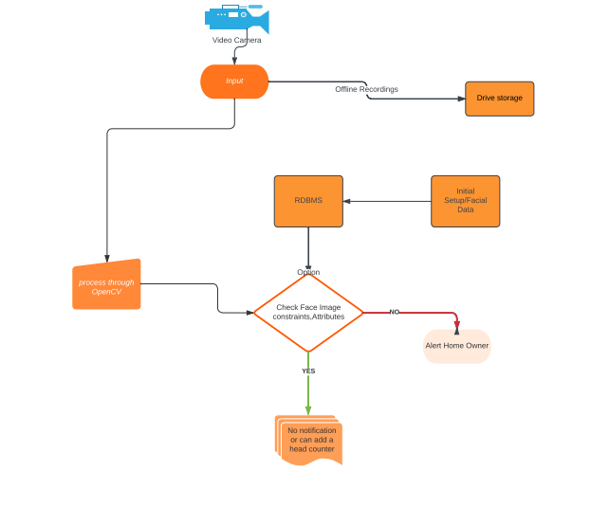
PROJECT MODEL

Slide 7
MARKET RESEARCH
Here are a few competition in market that are readily available in the present market:
SimpliCam: Owned by an American company Simplisafe, is a standalone camera which provides Privacy shutter, Infrared Night vision, Two-way audio, 1080p resolution and 120 degrees field of view.
Ring: Owned by Amazon, is an easy to set-up wireless surveillance system device.
Nest: A device in the line of smart home products provided by Google.
Lorex: A well-known offline security systems introduced by a Chinese manufacturer called Dahua.

Slide 8
MARKET RESEARCH
Limitations :
Above mentioned options could provide good quality, but their product plans are expensive.
Complex functions inside the hardware needs high quality internet speed.
Power consumption is high.
SimpliCam couldn't cover the lens and power port from being exposed to dust outdoors.
Though companies like Laurex made easy system, it was banned due to human rights abuses with their data.

Slide 9
BUSINESS MODEL& HOW TO MONETIZE
For this product to be what we are planning it to be it Has to undercut the current market while delivering the same service as the competition
Provide software to already existing hardware(Existing surveillance equipment), Or provide a subsidized price for the full installation of Hardware + software at a competitive price
The product can be provided to both consumers and Businesses

Slide 10
EYE SPY
Software support can be bought at subscription basis
1. Monthly(slightly higher than the other plans)
2.Quarterly(would have aggressive pricing)
Other means of income generation is to collaborate with other Companies such as ‘Hikvision’ to provide a competitive price plan for the consumers
i.e. Co-ordinate with surveillance product companies to integrate our software with their security cameras.

Slide 11
TEAM ROLES & CONTRIBUTIONS
Alexander Moore – Video Processing
Anusha Verma – Clientside Handling & Integration
Sai Krishna Korukoppula – Model Training
Farzad Ahmed Shaik – Backend Handling

Slide 12
TOOLS & MODE OF COMMUNICATION
IDE
VS-Code
Workbench
Deployment
Docker
AWS
Tools used and communication
Lucid for Brain-storming, Planning, Timeline tracking
Github, Gitlense.
Discord

Slide 13
EYE SPY
THANK YOU

